Slide 1
Judgment and Decision Making in Information Systems
Utility Functions,
Utility Elicitation, and Risk Attitudes
Yuval Shahar, M.D., Ph.D.

Slide 2
Utility Functions
Assuming a lottery f with a set of states S and a set of prizes X, a utility function is any function u:X x S -> R (that is, into the real numbers)
Note: The utility of a monetary prize of $X, u($X), is not necessarily equal or proportional to |X|, especially when X is a significant portion of the decision maker’s net worth
When X is sufficiently small relative to the current wealth, it is reasonable to assume a linear utility function of the money

Slide 3
The Expected-Utility Maximization Theorem
Theorem: The VNM axioms are jointly satisfied iff there exists a utility function U in the range [0..1] such that lottery f is (weakly) preferred to lottery g iff the expected value of the utility of lottery f is greater or equal to that of lottery g

Slide 4
Lottery Preference
The utility of a lottery, u(L), is the expected utility of the prizes of L
Lottery preference
  L₁  L₂ iff u(L₁) > u(L₂)
Utility functions are strategically equivalent iff when applied to two lotteries, preference ordering is preserved
Utility functions u, u` are strategically equivalent iff each function is a linear transformation of the other
  u’(X) = α + β u(X), β>0

Slide 5
Certain Equivalents and
Indifference (Preference) Probabilities
1
P
A
B
≡
1-P
C
B is the Certain Equivalent of the lottery <A, p; C, 1-p>
P is the indifference probability between B and lottery <A, p; C, 1-p>
P is also called the preference probability of lottery <A, p; C, 1-p> compared to B

Slide 6
The Civil Lawsuit Case
Consider the option of either
  A: paying $50,000 and gambling
    (A₁) That the jury will decide in your favor and give you $1M (net gain: $950K), or
    (A₂) That you lose the case (and the $50K)
  B: settling out of court for $650,000 for sure
=> Utility functions are not likely to be linear for significant losses or wins!

Slide 7
Elicitation of Utility Functions
Utilities are individual and subjective
Utilities need to be elicited from the decision maker to support their decision
There are two basic approaches:
  Determining the indifference probabilities, given a certain equivalent
  Determining a certain equivalent, given an indifference probability

Slide 8
Utility Elicitation (I):
Determining the Indifference Probability
Ask the decision maker:
  Given outcomes R₁ (best), R₁ (worst), and potential certain equivalent R_{eq},what is the indifference probability p of the deal < R₁,p; R₀, 1-p> relative to R_{eq}. That is, U (R_{eq}) = p
Search for p iteratively by limiting the interval containing it from both ends in “ping pong” fashion (e.g. 99%, 1%, 90%, 10%…) until the indifference probability is found
Note: For non-continuous outcomes such as {Win, Draw, Lose}, using linear (convex) combinations of the value of the outcome to express the value of the certain equivalent would be meaningless

Slide 9

Eliciting an Indifference Probability: The Standard Device
Decision makers often need visual support to to acquire their utility function as an indifference (preference) probability
The most common method is a standard device or a standard gamble
  A standard gamble wheel
  An urn with red and black balls
  The “ping pong” death game
Linear analog scales have been used as well
  Seem less reliable

Slide 10
Utility Elicitation (II):
Determining the Certain Equivalent
Assume u(R₀) = 0, u(R₁) = 1
Ask the decision maker:
  What would be your certain equivalent for a deal of
  < R₁,50%; R₀, 50%> ? Assume it is R_{eq}, u(R_{eq}) = 0.5
Ask iteratively for the certain equivalent of the deal < R₁,50%; R_{eq}, 50%>, the deal < R_{eq}, 50%; R₀,50%> , etc. The utility of these intermediate certain equivalents must be 0.75, 0.25, etc.
Continue until utility curve is sufficiently clear
Note: Useful (only) for continuous outcomes that can be meaningfully combined in linear fashion (e.g., $$)

Slide 11

Eliciting Utility Curves Through the Certain Equivalent Method
For example, assume R₁ = $100K, R₀ = 0$
Utility
1
0.5
0
x
x
x
x
$0 $50K $100K
Money

Slide 12
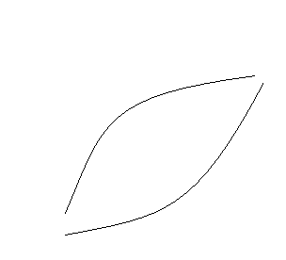
Utility Curves and
Risk Preference
Concave curves (U``(R) < 0, or decreasing marginal utility) represent the utility function of a risk-averse decision maker
Convex curves (U``(R) > 0, or increasing marginal utility) represent the utility function of a risk-seeking decision maker
Linear curves represent the utility function of a risk-neutral decision maker
1
0.5
0
Utility
Value

Slide 13
Risk Premiums
Assume a deal < R₁,50%; R₀, 50%>
Assume R_{mid} = (R₁ + R₀)/2
If R_{eq} = R_{mid} the person is risk neutral
If R_{eq} < R_{mid} the person is risk averse and (R_{mid} – R_{eq}) is the risk premium they are willing to pay to avoid the risk of the 50/50 gamble on R₁ vs. R₀
If R_{eq} > R_{mid} the person is risk seeking and (R_{eq} – R_{mid}) is the amount they need to be paid to take the riskless expected-value certainty equivalent instead of taking the gamble

Slide 14
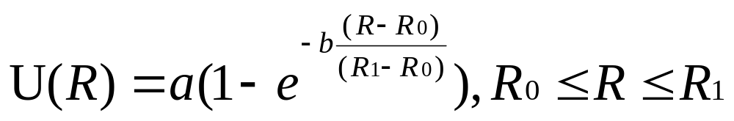
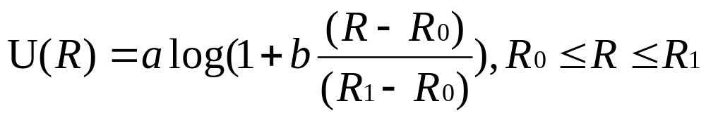
Utility Function Types
Linear
  U(R) = a + bR, b>0
Exponential
Logarithmic

Slide 15
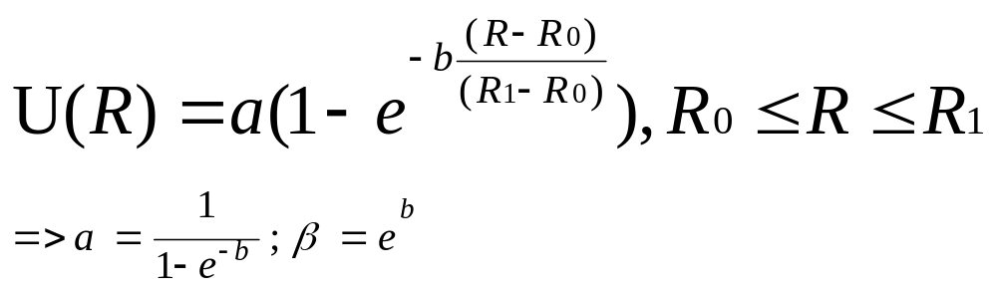
Exponential Utility Function
When R= R₀, U(R₀)= 0 for all a,b
When R= R₁, U(R₁) = 1 and we get the above relationship
β is the ratio of the slopes at the worst and best value

Slide 16
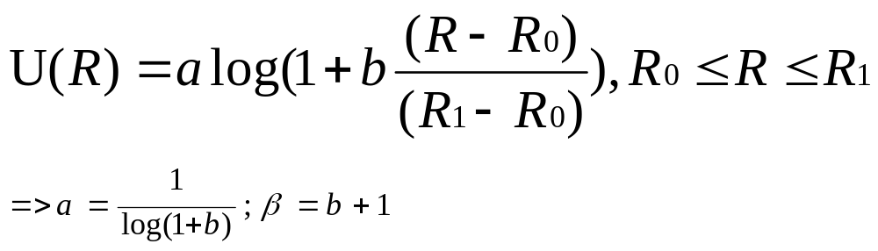
Logarithmic Utility Function
When R= R₀, U(R₀)= 0 for all a,b
When R= R₁, U(R₁) = 1 and we get the above relationship
β is the ratio of the slopes at the worst and best value

Slide 17
Using Utility Function Types to Elicit Utility Functions
Assuming an exponential or a logarithmic utility function, we need not use the indifference probability or the certain equivalent methods
All we need to do is acquire from the decision maker
  R₁ (best possible outcome)
  R₀ (worst possible outcome)
  β (ratio of the marginal returns near the worst and the best outcomes)
Semantics:
  β is the Risk Aversion coefficient
  1/ β is the Risk Tolerance coefficient

Slide 18
The Allais Paradox, Revisited
What would you prefer:
  A: $1M for sure
  B: a 10% chance of $2.5M, an 89% chance of $1M, and a 1 % chance of getting $0 ?
And which would you like better:
  C: an 11% chance of $1M and an 89% of $0
  D: a 10% chance of $2.5M and a 90% chance of $0

Slide 19

The Allais Paradox, Graphically
10% 89% 1%
A
$1M $1M $1M
B
$2.5 $1M $0
C
$1M $0 $1M
D
$2.5M $0 $0

